Slide 1


Patient Guide
ARTHROSCOPIC SHOULDER SURGERY
2022-2024
Prepared by:
Dr. Frank McCormick, MD
:

Slide 2
Table of Contents
I. | Introduction Letter | 1
II. | Understanding the Process | 2
III. | Surgeon Credentials | 3
IV. | Our Care Pledge | 4
V. | Our 100 Days to Health Program | 6
VI. | My procedure explained | 8
VII. | How painful is the procedure? | 9
VIII. | What does my recovery look like? | 10
IX. | Orthobiologic Augmentation Options | 11
X. | Link to rehab protocols | 12

Slide 3

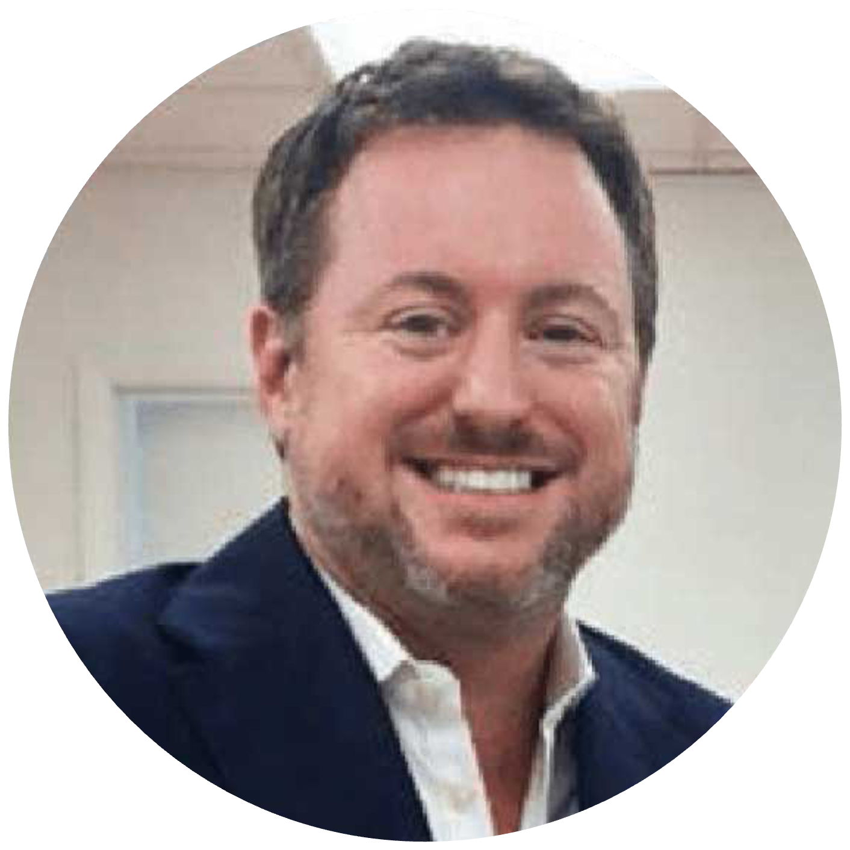

Introduction Letter
Dear Patient,
We are honored you decided to have Dr. McCormick perform your surgery. We are all deeply committed to your recovery and making this process as enjoyable as possible.
This packet should provide you with information to help minimize any confusion or anxiety regarding your upcoming surgery. We realize that surgery is a stressful time, and we will do our best to get you through this difficult period in your life with as few problems as possible.
Please expect a call from my surgical coordinators within 2-3 business days to organize your surgical recovery. We will also seek to enroll you in our 100 days to joint health program at that time.
Once we set a surgical date, we will be you in the office to review any pre-surgical instructions, review and dispense, and post-operative medications and pain control modalities such as the ice machine and durable medical equipment. This is a good time to address work notes, pharmacy updates, post-operative transport, and home care plan and physical therapy programs.
The surgery is performed at a surgery center and you will go home the same day. The night before surgery, you should not have anything to eat or drink after midnight. If you have a family with you when you go to surgery center , the family may wait in the waiting room. You will need someone to drive you home. We can provide transportation to and from the surgery center if needed.
Our 100 Days to Health Surgical Program is available to optimize your recovery.
If any problems should arise during your recovery, you can contact Dr. McCormick or any of his professionally trained staff through our messaging platform.
We wish you all the best and a speedy recovery.
Frank McCormick MD
Shoulder and Sports Orthopedic Surgeon

Slide 4
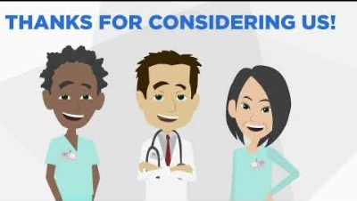
The Surgical Process
A. | Proven steps to return to sports/ADLS within 100 days
B. | Direct Access to surgeon and health care team via Hippa Compliant APP via Text
C. | Remote pain and activity monitoring
D. | Monitored benchmarks, continuous engagement and education—small steps lead to a long journey
V

Slide 5
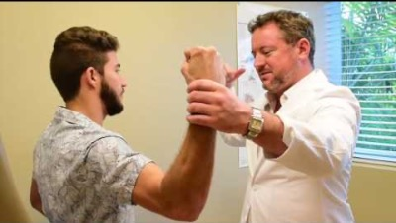
Surgeon Credentials
DR. FRANK MCCORMICK, MD
Medical School
University of Pennsylvania School of Medicine
Officer U.S. Navy
Surgical Internship Naval Medical Center, San Diego CA
Residency
Harvard University, Boston MA
Fellowship
Rush Sports Medicine, Chicago IL
Orthopedic Surgeon
Dr. Frank McCormick, MD is a board-certified orthopedic surgeon who specializes
in outpatient extremity care, sports medicine, cartilage/meniscal/stem cell transplantation,
joint preservation, and arthroscopic treatment of the shoulder, hip, and knee.
He is a former staff surgeon at the Affiliated Harvard Medical Faculty Physicians group at
Beth Israel Deaconess Medical Center in Boston MA, a Harvard Medical School Teaching Institution. He sees patients at seven Florida office locations as a member of the University Orthopedic Care team.
Dr. McCormick obtained his medical degree from the University of Pennsylvania School of Medicine. Upon graduation, he was commissioned as an officer in the United States Navy where he performed his surgical internship at the Naval Medical Center San Diego, followed by serving as a F/A-18 Fighter Jet Flight Surgeon for the United States Marine Corps VMFA-314 squadron. Subsequently, he completed his orthopedic surgery residency at the Harvard Combined Orthopedic Residency Program where he was selected as a Chief Resident at Massachusetts General Hospital. He then completed an Orthopedic Sports Medicine Fellowship at the world-renown Rush Sports Medicine Fellowship under the guidance of Dr. Bernard Bach Jr. Recently, he completed the prestigious International Cartilage Repair Society (ICRS) Sanofi traveling fellowship in joint preservation and cartilage regeneration.
Dr. McCormick has achieved regional, national and international recognition for his clinical research endeavors. He is an award-winning lead or co-author of over 16 studies in the last 10 years. He is a co- author on the paper that won the Arthroscopy Association of North America (AANA) J. Whit research prize, a co-author on the best paper prize at the European SECEC/ESSSE annual meeting, and is the lead author for the 2011 International Society of Arthroscopy and Knee Orthopedic Surgery (ISAKOS) John Joyce Award, which goes to the top paper from a resident or fellow in sports medicine across the globe. He has written over 100 peer-reviewed papers published in top orthopedic and sports medicine journals while speaking at regional, national or international conferences over 200 times.
Dr. McCormick is commissioned as a Lieutenant Commander in the United States Navy Reserve. He has also served as assistant team physician for the Chicago Bulls (NBA), Chicago White Sox (MLB), and Depaul University (Division I) Men’s and women’s basketball and soccer teams. He has also provided medical care for the New England Patriots (NFL), CrossFit World Competitions, and Professional Volleyball.
Dr. McCormick is an Assistant Clinical Professor at Florida International University and has had an academic appointment at Harvard Medical School. His research interests include value-based orthopedic care delivery, surgical decision-making, the clinical outcome assessments of novel minimally invasive biological approaches to early arthritis, joint instability, cellular, organ, and stem cell transplantation.

Slide 6
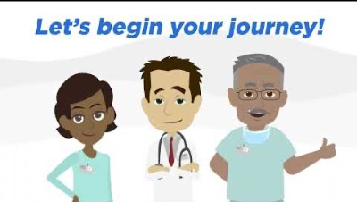

Our Care Pledge
The surgical pursuit of excellence is Dr. McCormick’s pledge to you. We target optimal outcomes and use value-based care approaches to ensure your satisfaction.
Our multi-specialist care teams provide comprehensive, customized care plans which include cutting-edge surgical and non-surgical techniques. We use full spectrum minimally invasive joint preservation biologic approaches. We employ innovative surgical techniques to optimize safety and minimize risk.
By utilizing top-of-the-line surgical products with team coordination programs, direct communication, and multimodal pain control regimens; we optimize your recovery.
During our “surgical planning and risk reduction” process, our team reviews your information and surgical plan to determine additional tests that may benefit your experience.
We coordinate any assistance or therapy you need at home, as well as medications, which may be provided before, during, and after surgery.
Finally, our “100 days to health” program helps ensure we identify and mitigate complications while you heal, provides direct access communication to the team, and assists you through the entire recovery.
Together, we aim to return you to the healthy, optimized lifestyle you deserve

Slide 7
Understanding the process and Our 100 Days to Health Program
Surgical success is much more than the surgery itself. We are committed to your success throughout the entire process
The 100 Days to Health Program is a value-based care program run by Dr. McCormick and surgical care team. The 100 Days to Health is the time period after you sign your surgical consent form, all the way until 90 days after your surgery. We aim to maximize patient-to-provider communication and optimize your successful outcome in all areas of surgery. We know surgery is difficult and this program is designed to provide you with all the tools needed to have the best experience possible through University Orthopedic Care and with Dr. McCormick. If you are enrolled in the 100 Days to Health Program you will have access to the following resources:
The day before your surgery, you will receive a call from Dr. McCormick, or his team member, who will provide you with some reminders regarding your procedure and also be able to answer your questions.
At your Pre-op appointment, you will be given a “Swag Bag” that is going to provide the essentials for your at-home rehabilitation program and also supplementary video instruction to show you the exact steps of your rehab.
During the 100 Days to Health, you will be asked to provide some basic information such as phone number and email address so you can utilize the MyMobility platform that will track and monitor your progress for the doctor to evaluate as you progress through your 100 days.
One of the main functions of the 100 Days to Health is to increase patient education on the procedure and all the relevant protocols. We will provide you with multiple Youtube videos to educate and empower you regarding your procedure.

Slide 8
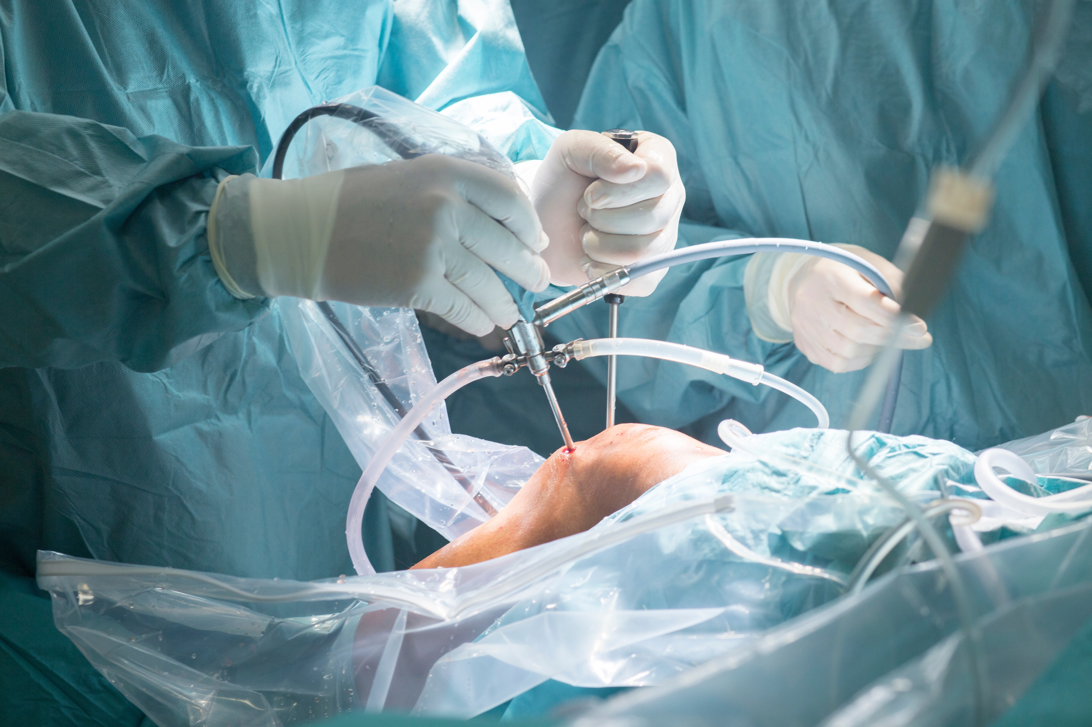
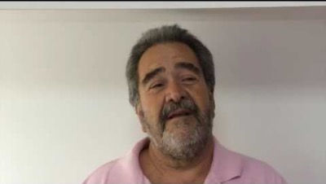
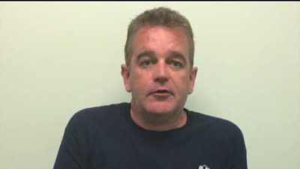
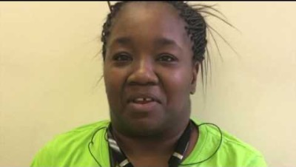
Arthroscopy Explained
Description
arthroscopy is a quick, minimally-invasive procedure performed in an office or surgery center to address shoulder pain and pathology within the joint. It is performed through a ”Key-hole” incision (3-7mm) using a camera to visualize the tissue and specialize surgical instrumentations. The duration of the surgical procedure is expected to be 15-60 minutes and you can stay awake or be asleep. Most people choose to go to sleep. Your anesthesia team will talk to you in more detail about your options
Common complications we avoid
Arthroscopy is a safe and effective procedure with reliable positive results.
The surgical procedure and anesthesia is actually safer than driving in your car.
Specific risks of the procedure include infection, stiffness and scarring, repair failure and a very very small chance of nerve or blood vessel injury.
We take specific steps to address and avoid the common complications of surgery and we will review this with you directly.
Expected Results
Patient Testimonial Videos
Arthroscopy is expected to turn moderate to severe pain into minimal or no pain often within weeks.
Arthroscopy is expected to normalize function of the joint within weeks to month.
85-90% of patients undergoing arthroscopic surgery experience good to excellent results
70-80% of athletes are able to return to their sport

Slide 9

Successful Tools to Reduce or Eliminate Pain after the Procedure
The Process:
Medications
Post-surgical Narcotics
Anti-inflammatories, oral, IV and creams
Tylenol
Nerve Medications
Local anaesthesia
Pre-op nerve medication
Muscle relaxants/Sleep aids
Supplement and OTC medication
CBD and Canniboids
Shoulder arthroscopy can be a painful process. But it doesn’t have to be!
Follow our lead and we can ensure your comfort.
We use a multi-faceted approach to ensure your comfort
We monitor your comfort throughout the course
Our close contact allows for small effective adjustments.
We will review the post-operative pain program in greater detail prior to the surgery and often times review again after surgery
Narcotics are dangerous, but often necessary after surgery. State law mandates an electronic prescription for a maximum 3 days supply. We require doctor visits (including telemedicine) for narcotics refills.
Braces and Modalities
Additional Therapies
Brace for comfort
Brace for protection
Ice Machine/ Compression
Home Exercise program
Cognitive Therapy
TENS device
Massage/Ultrasound/Physical therapy
Acupuncture

Slide 10


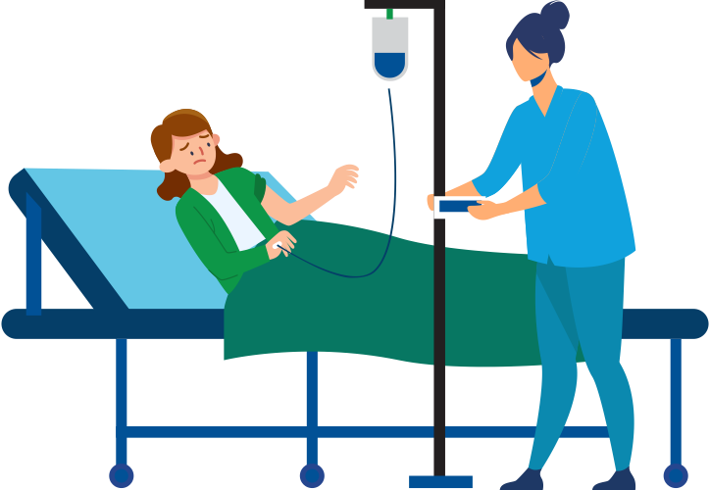


What are My Expected Procedure Benchmarks and Results?
Everyone is unique so this warrants a specific discussion regarding individual goals.
Below is a general pathway to frame the discussion
Surgical recovery
0-72 hrs Surgical Plan
Return to recreational activities, occupation demands
6-12 weeks
Long term result achievement, re-injury risk mitigation, performance optimization
1-2 years
Return to work and normal life/protecting the healing.
1-6 weeks
Return to sports and fitness/training your body after injury
3-12 month

Slide 11
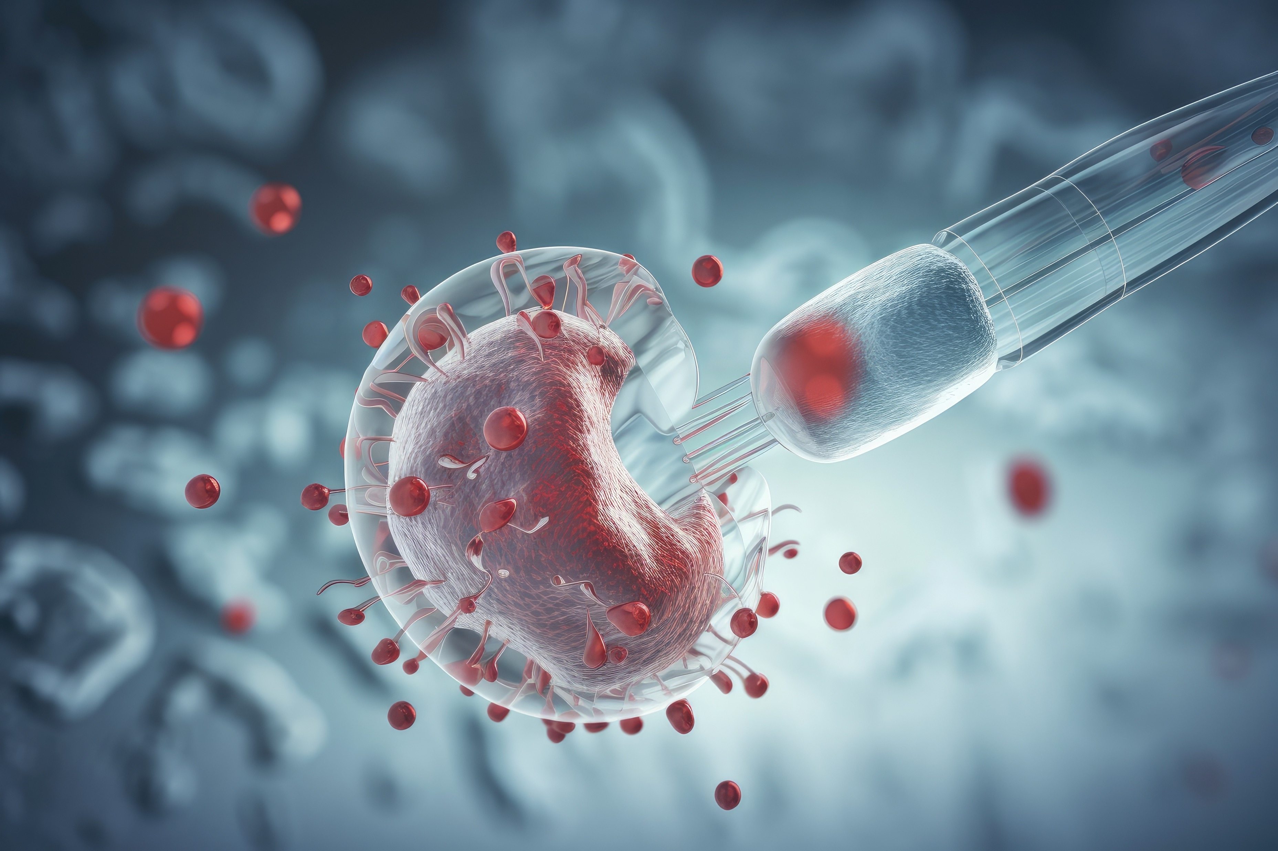
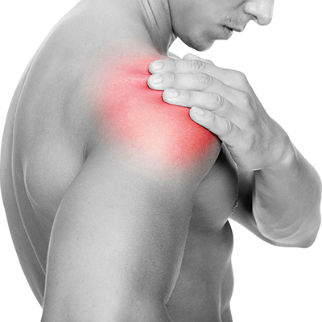

Orthobiologic Options
Patches and tendon tissue augmentations
Stem Cells
PRP
Bone Grafts and substitutes
Cartilage
Computer-guided Technology
We Offer State of The Art Surgical and Non-surgical Options

Slide 12
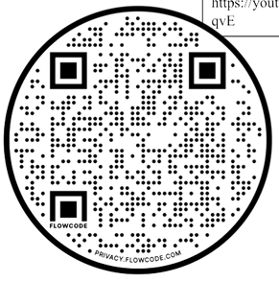
Post-Op Recovery Protocol
Rehab For Your Arthroscopic Surgery (General Guidelines)
1-4 Weeks
4 - 6 Weeks
6 - 12 Weeks
3 - 12 Months
Joint Protection 1-4 weeks
Active ROM local joints
True Passive (ONLY) ROM. NO ACTIVE RESISTANCE.
Home Exercise Program
Pendulums, Heel Slides, quad sets,
Begin Active Assist ROM and advance to Active as Tolerated Elevation in scapular plane and external rotation as tolerated No Internal rotation or behind back until 6wks.
Begin Isometrics at 6wks
Active Assist to Active ROM As Tolerated Light stretching at end ranges
Joint Isometrics
Advance to full ROM as tolerated with passive stretching at end ranges Advance strengthening as tolerated: isometrics, bands, light weights (1-5lbs); 8-12 reps/2-3 sets
stabilizers Only do strengthening exercises 3x/week to avoid tendonitis
Begin eccentrically resisted motions, plyometrics (ex. Weighted ball toss), proprioception (es. body blade)
Begin sports-related rehab at 4 ½ months, including advanced conditioning Return to throwing at 6 months
Return to sports 3-6 months eval
MMI is usually at 12 months post-op
AT-HOME REHAB: YOUTUBE VIDEO
FOR USE 48 HOURS POST OP WITH EQUIPMENT GIVEN
AT THE SURGERY CENTER
(SCAN WITH IPHONE CAMERA OR A QR CODE READER APP)

